Slide 1


Final Project Presentation
GROUP 4
YU ZHANG
YONGQI YU
LIBIN CHEN
JOANNA CHANG

Slide 2

Outline
Product Overview
Pipeline Selection
Model
Chunking strategy
Analytics Engine Components
Summarization, Visual feature, Product feature, Sentiment analysis
Topic extraction, Image generation summary
Image Generation
AI Agentic Workflow
Challenges and Limitations
Future Enhancements

Slide 3
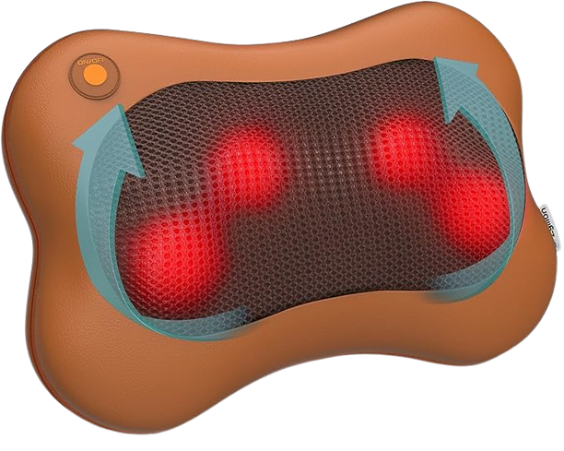
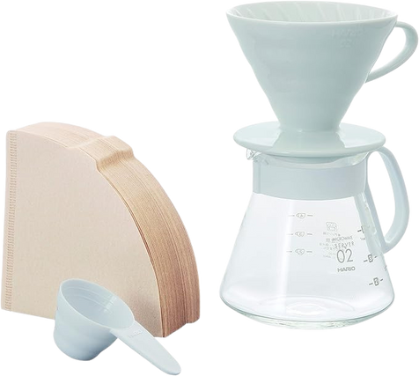
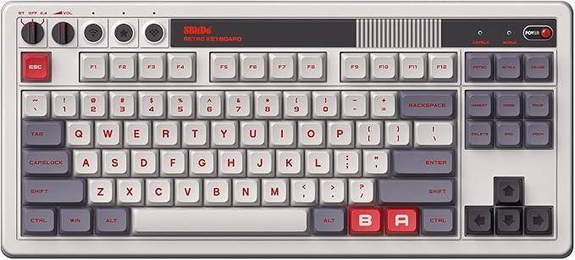
Overview of Product Categories
ZYLLION SHIATSU BACK AND NECK MASSAGER WITH HEAT
8BITDO RETRO MECHANICAL KEYBOARD
HARIO V60 CERAMIC POUR OVER COFFEE SET
Health & Household
PC Accessories
Home & Kitchen
4.4⭐️ (50,884 reviews)
4.8⭐️ (2,183 reviews)
4.6⭐️ (1,921 reviews)
Notes:
This slide gives an overview of the three product categories we selected for our study: a massager, a retro-style keyboard, and a pour-over coffee set.
One important observation is the large difference in review volume across these products. For example, the massager has far more reviews than the keyboard or the coffee set, which directly affects how we handle text preprocessing.
Overall, the diversity in categories and review styles provides a good foundation for testing how well our pipeline generalizes.

Slide 4
Rationale for Selection
DISTINCT CATEGORIES
VISUALLY &
SEMANTICALLY RICH
DIVERSE REVIEW VOLUMES
Three distinct product categories enhances the diversity of the evaluation and ensures varied textual cues for analysis
The selected products are visually and semantically rich, providing ample opportunities for exploring text-derived visual signals and enhancing model performance
Review counts range from 2,000 to 50,000, and all products have consistently high average ratings between 4.4 and 4.8
Notes:
Here we explain why we chose these three specific products.
First, they belong to distinct categories—home appliance, tech accessory, and kitchenware. This ensures our evaluation spans different shapes, materials, and semantic domains.
Second, all three products are visually and semantically rich. Their reviews contain plenty of descriptive information about appearance, texture, usability, and user experience, which is ideal for text-to-image generation.
Third, their review volumes are diverse, ranging from a few thousand to over fifty thousand. Despite the differences, the ratings are consistently high, which means we have access to detailed and mostly positive descriptions rather than noise or complaints.
These factors combined make the dataset suitable for evaluating both the robustness and limitations of our pipeline.

Slide 5
Pipeline Overview
 | Massager | Keyboard | Coffee Set
Model | gpt-5.1 | gpt-5.1 | gpt-5.1
How reviews are obtained (top reviews) | Web scraping (Selenium package) | Hard-coded | Hard-coded
# of reviews | 50 reviews | 5 reviews | 5 reviews
Chunking Strategy | chunk_size = 3000 overlap = 200 | None | None
Massager differs in
Review numbers
Chunking strategy
Notes:
Model: We use gpt‑5o because it understands long, noisy customer reviews well and can reliably extract fine‑grained visual and functional details. Fixing one model across all three products keeps the model factor constant, so differences in results mainly reflect our data and pipeline design (review volume, scraping vs hard‑coded, chunking), making comparisons cleaner.
Massager pipeline is the only one we applied “chunking strategy”.
Split text into chunks with overlap to preserve context.
chunk_size = 3000 (characters)
- to avoid a single chunk being too long for the model’s context, while also not making chunks so small that each one contains too little information
overlap = 200 (characters)
Neighboring chunks overlap by 200 characters so sentences are not cut off abruptly, helping the model keep local context when summarizing each chunk
The Massager has the most and longest real reviews, so we first do “chunk + per‑chunk summarization” and then merge into a condensed text, balancing information completeness with token and cost efficiency.

Slide 6
Analytics
Engine Components
 | Massager | Keyboard | Coffee Set
Summarization | per‑chunk summaries | None | Overall summary, pros/cons, keywords
Visual feature extraction | 1. Colors mentioned 2. Materials described 3. Size/Dimensions 4. Shape/Design elements 5. Textures 6. Visual features (buttons, straps, etc.) 7. Overall appearance | colors materials shape design visual features overall aesthetic | 1. materials 2. colors 3. shapes 4. textures 5. patterns 6. functional visual element 7. usage scenes
Product feature extraction (functional/ design) | 1. Functional Features (what it does) 2. Design Features (design elements) 3. Material Features 4. Size/Portability 5. Usage Context (where/how used) 6. Key Selling Points | functional_feature design_features connectivity unique_selling_points | None (combined with visual feature extraction)
Keyboard
No summarization
Fewer feature extraction
Coffee set
No product feature extraction

Slide 7
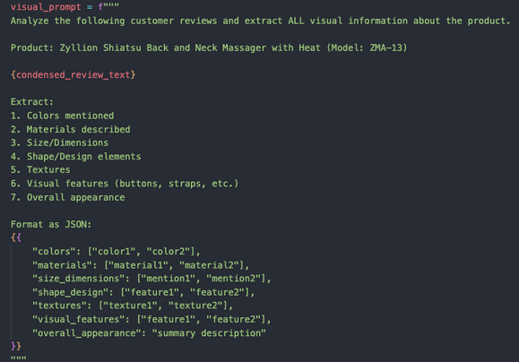
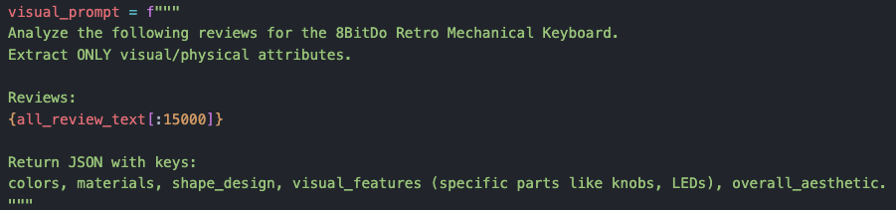
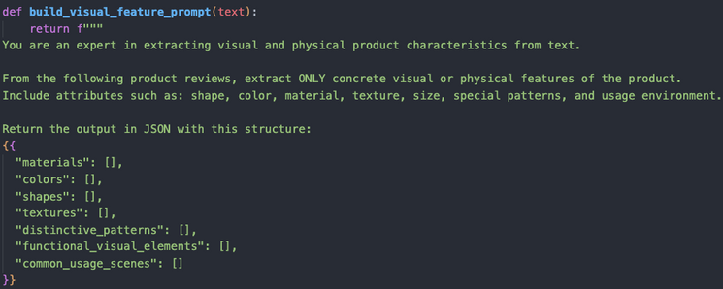
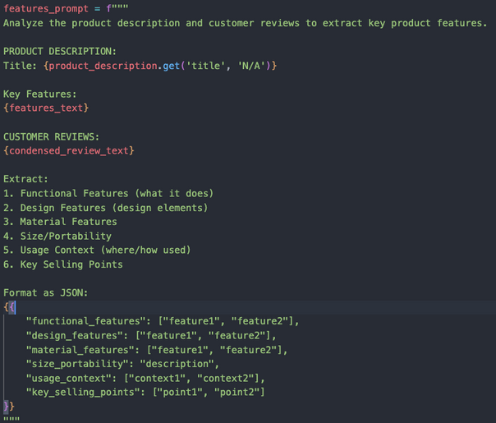
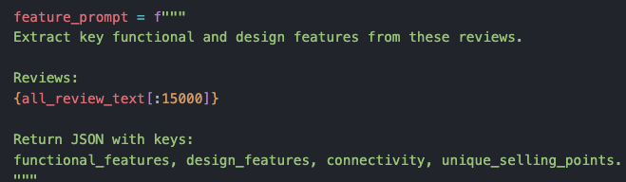
Visual feature & Product feature (conti.)
Notes:
Massager: comprehensive and detailed prompts
Keyboard: short and concise without much information
Coffee set: visual and product features are combined into one task

Slide 8
Analytics
Engine Components
 | Massager | Keyboard | Coffee Set
Sentiment analysis | Overall sentiment Sentiment themes Visual sentiment Satisfaction score | Overall sentiment Sentiment themes Visual sentiment | Overall sentiment Sentiment distribution Reasoning Summary
Topic extraction | Topic name Description Keywords Visual relevance | None | Topic Description Representative keywords Representative comments
Image generation summary | Visual description Key visual elements Recommended prompts for image generation | Visual description Key visual elements Recommended prompts for image generation | Recommended prompts for image generation
No topic extraction for keyboard
Recommended prompts are used directly to generate images

Slide 9
Image Generation
Transform textual product attributes extracted from customer reviews into realistic product images using image generation models.
We evaluate:
1. How well models convert text to visual appearance
2. How different prompts affect fidelity & realism
3. Model differences between OpenAI and SDXL

Slide 10
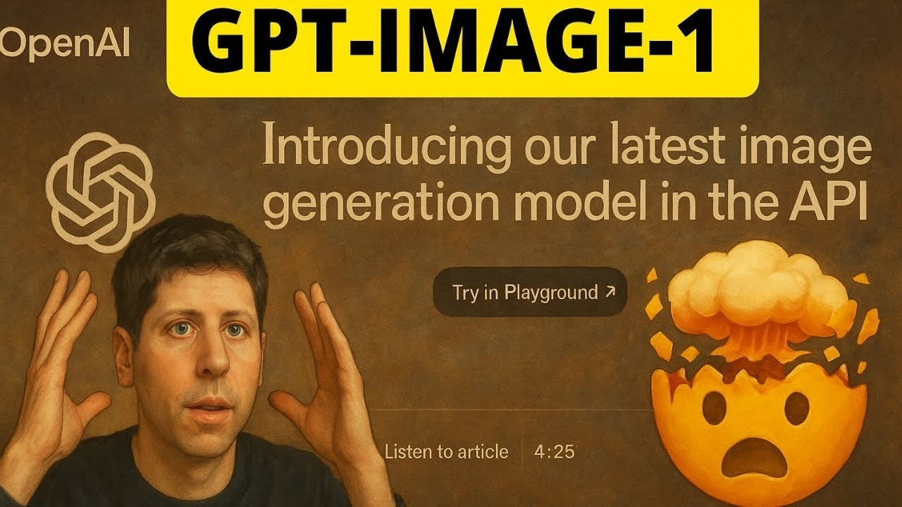

Models Used
OpenAI GPT-Image-1
Better at following instructions
More accurate geometry
Lower hallucination
Slightly simpler textures
Stable Diffusion XL (SDXL)
Better at texture realism & lighting
Very aesthetic images
Higher variability
Occasional shape/component errors
Source:
https://stablediffusionxl.com/
https://platform.openai.com/docs/models/gpt-image-1

Slide 11
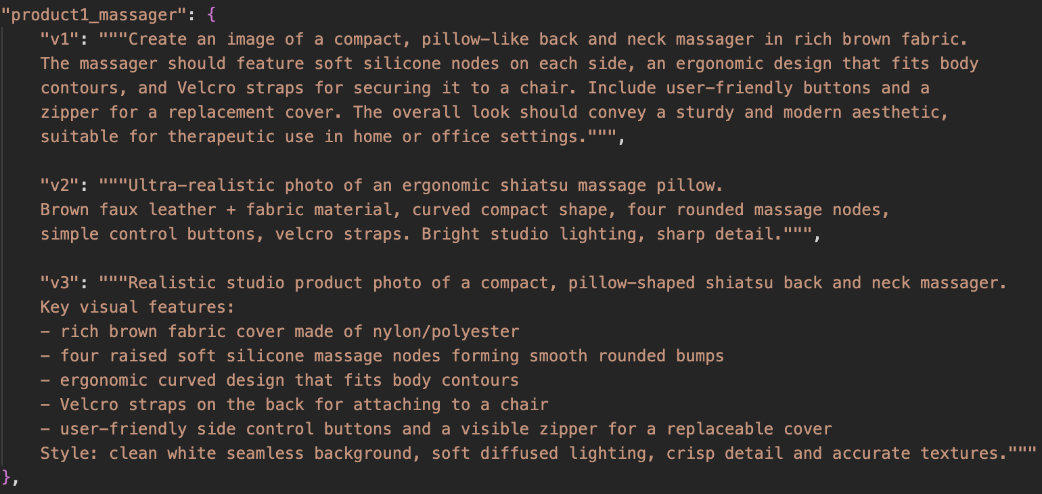
Our Prompt Versioning Strategy
For each of 3 products: 3 prompt versions
Prompt 1: Natural Language Prompt
Reads like a normal description, minimal structure
Prompt 2: Condensed Attribute-Focused Prompt
Removes storytelling language
Focuses on essential product features
More consistent than prompt 1
Prompt 3: Structured Photorealistic Prompt
Most structured and detailed
Includes materials, geometry, textures
Includes lighting, background, photography style

Slide 12
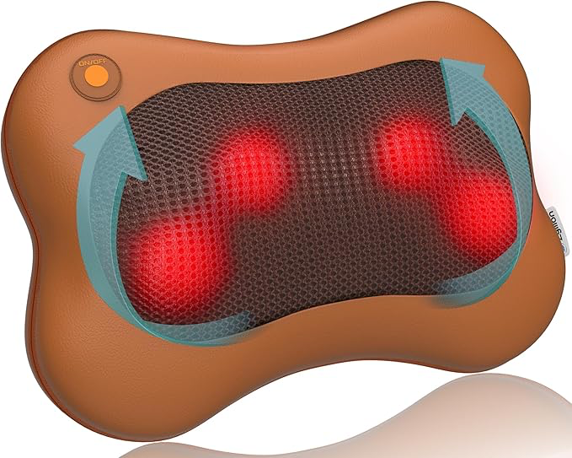
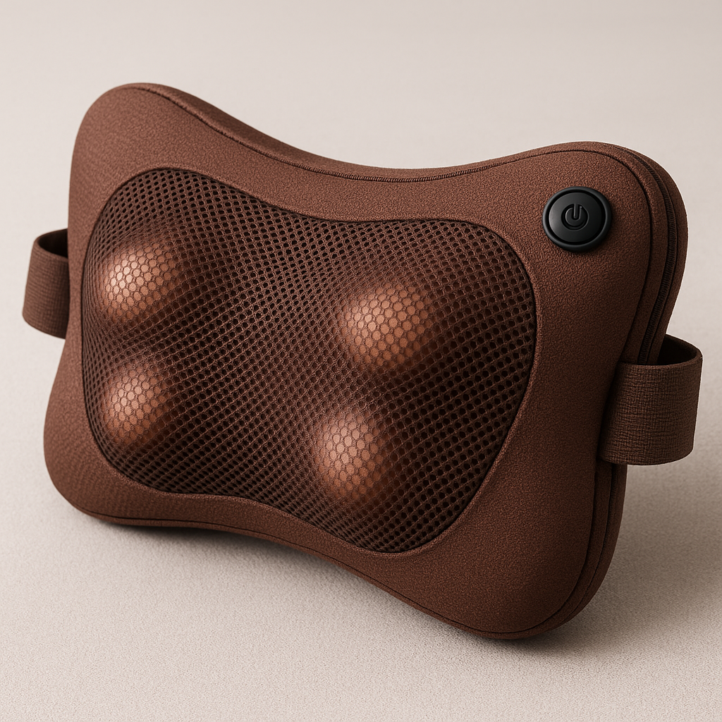

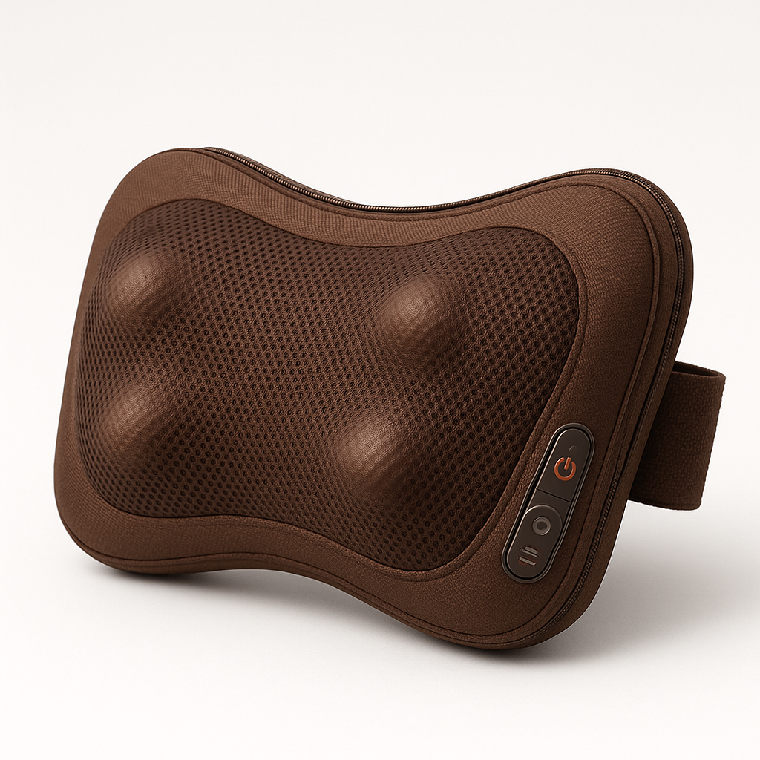
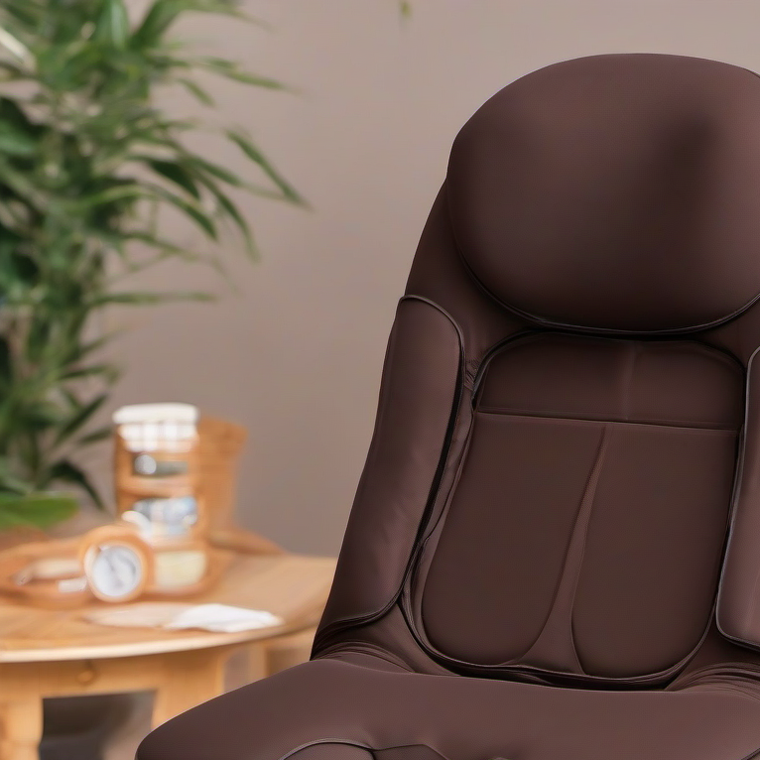
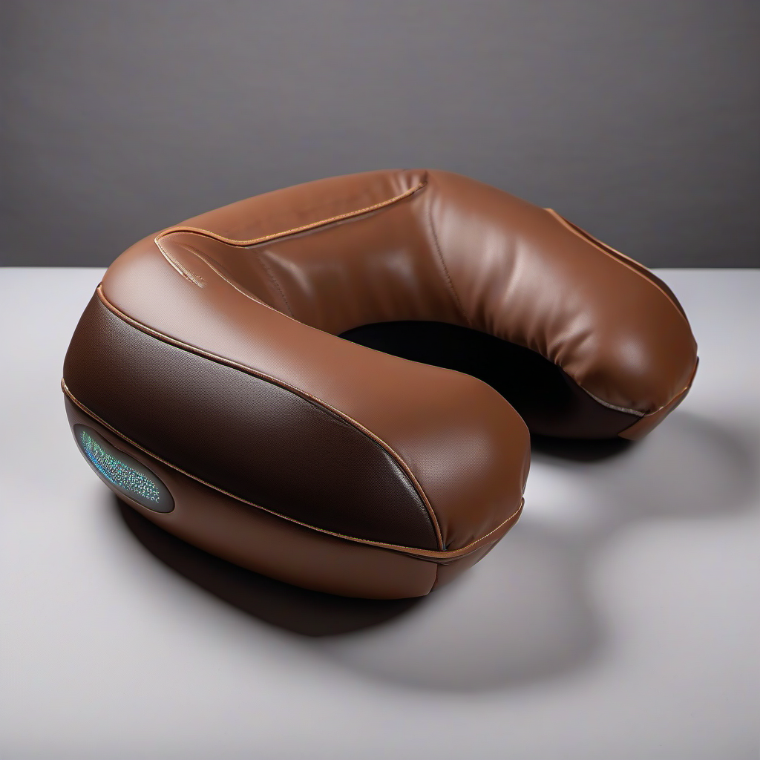
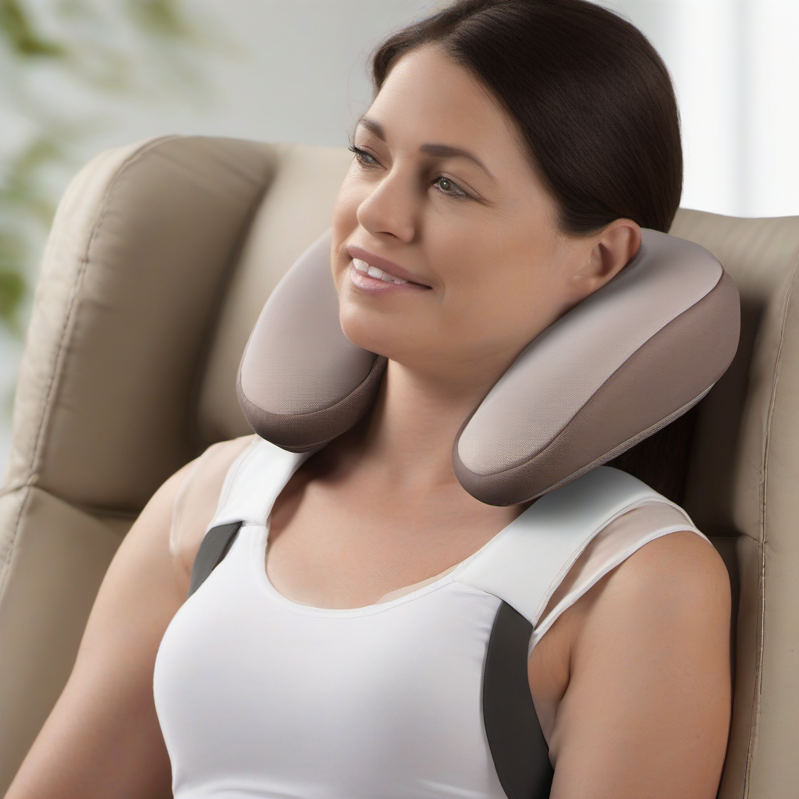
Product 1 (Massager)
OpenAI
Key Findings:
OpenAI generated images closely match the real massager’s shape and color.
The pillow-like outline and four glowing massage nodes are accurately captured.
Button placement is generally correct, though design differs slightly.
Models did not reproduce the blue rotation arrows seen in the real product.
SDXL outputs show higher realism but lower accuracy, often drifting into neck pillows.
SDXL

Slide 13

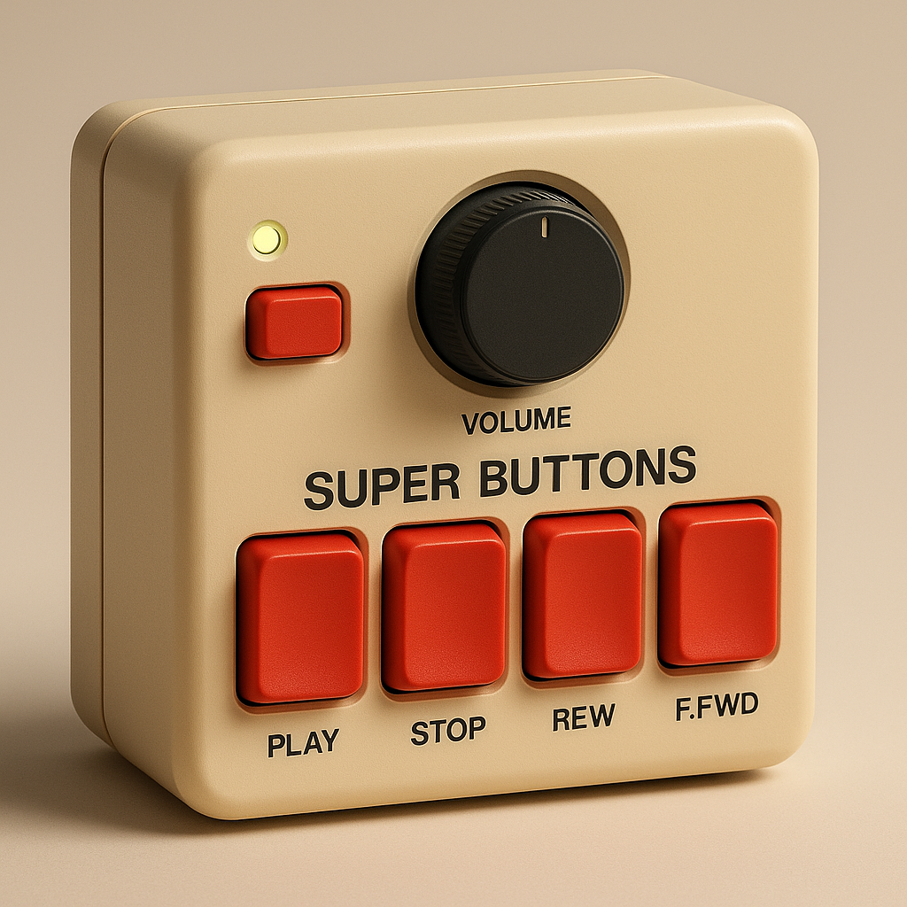
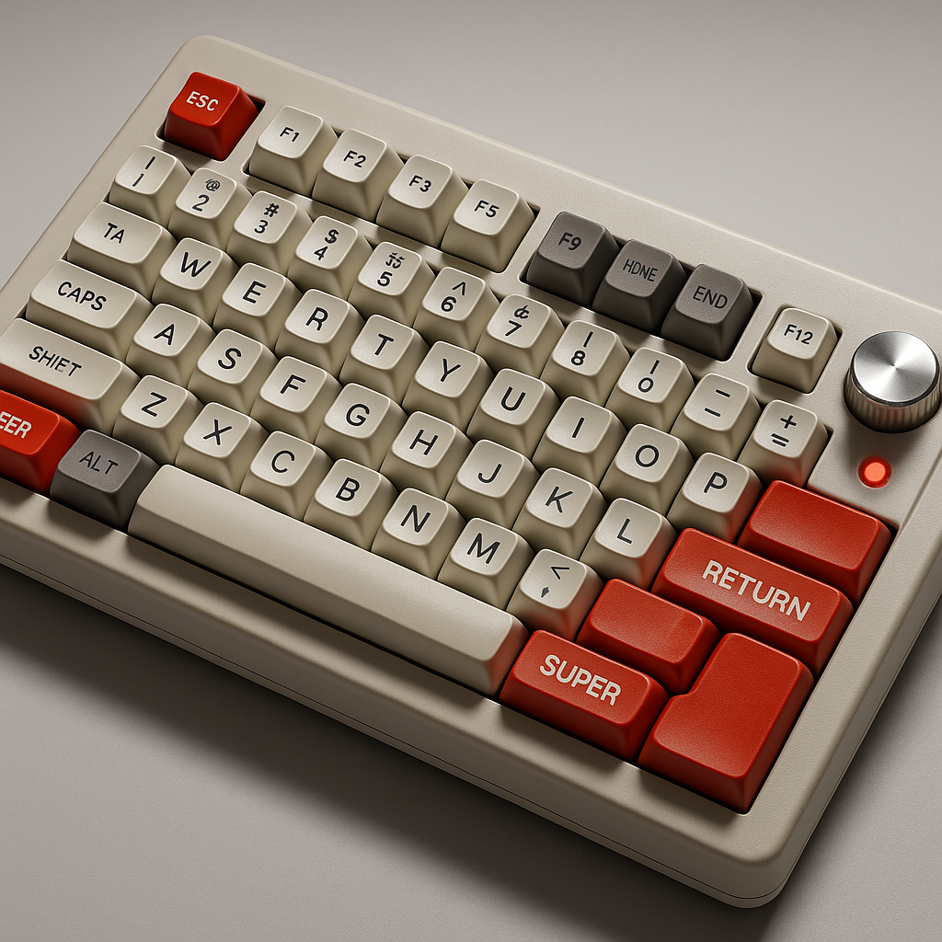
Product 2 (Keyboard)
Prompts
Initial prompt (v1):
Create a image of a retro-style audio device with a boxy shape made of thick plastic. The device has a creamy grey body adorned with bold red accents. It features large 'Super Buttons' on the front, a prominent central volume knob, and a soft glowing power LED indicator. The overall design exudes a nostalgic aesthetic reminiscent of classic electronics, highlighting concave keys and a user-friendly layout.
Updated prompt (v2):
Ultra-realistic retro-style mechanical keyboard modeled after classic 8-bit consoles. Matte creamy grey ABS plastic housing, bold red accent buttons, oversized Super Buttons, concave retro keycaps, a metallic central volume knob, and an illuminated LED indicator. Bright studio lighting, sharp detail.

Slide 14
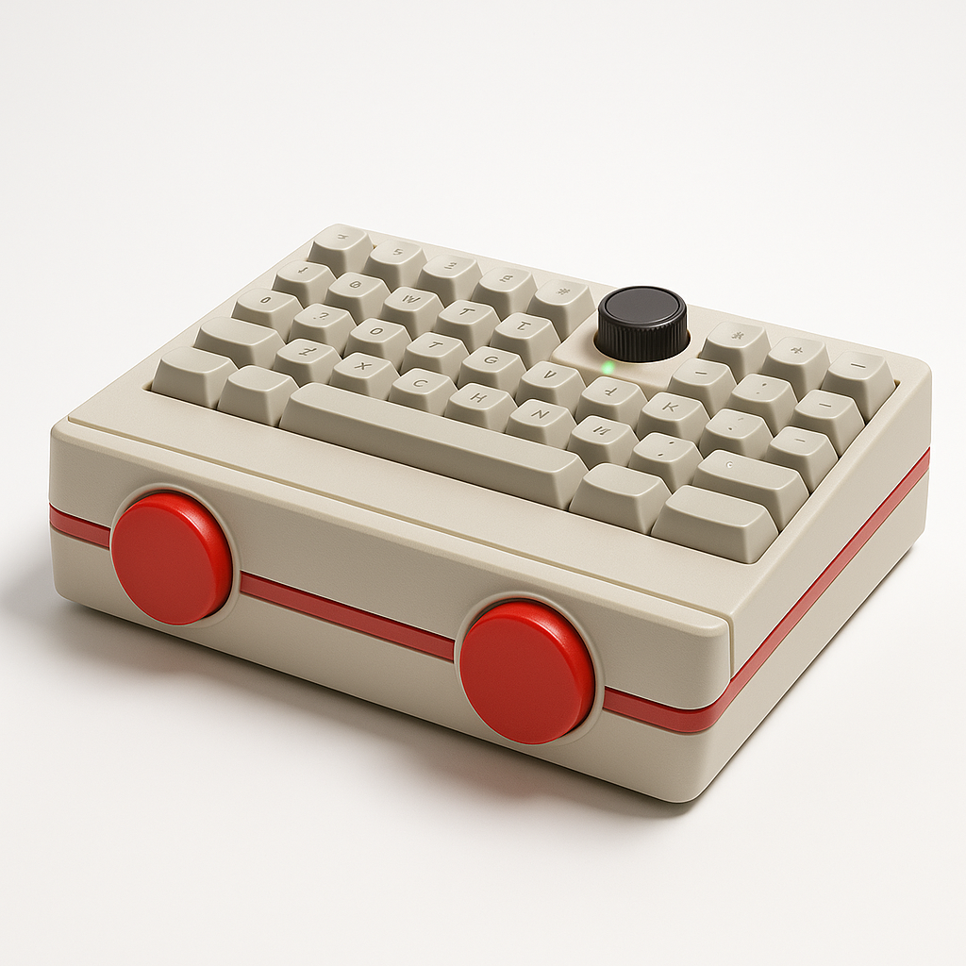
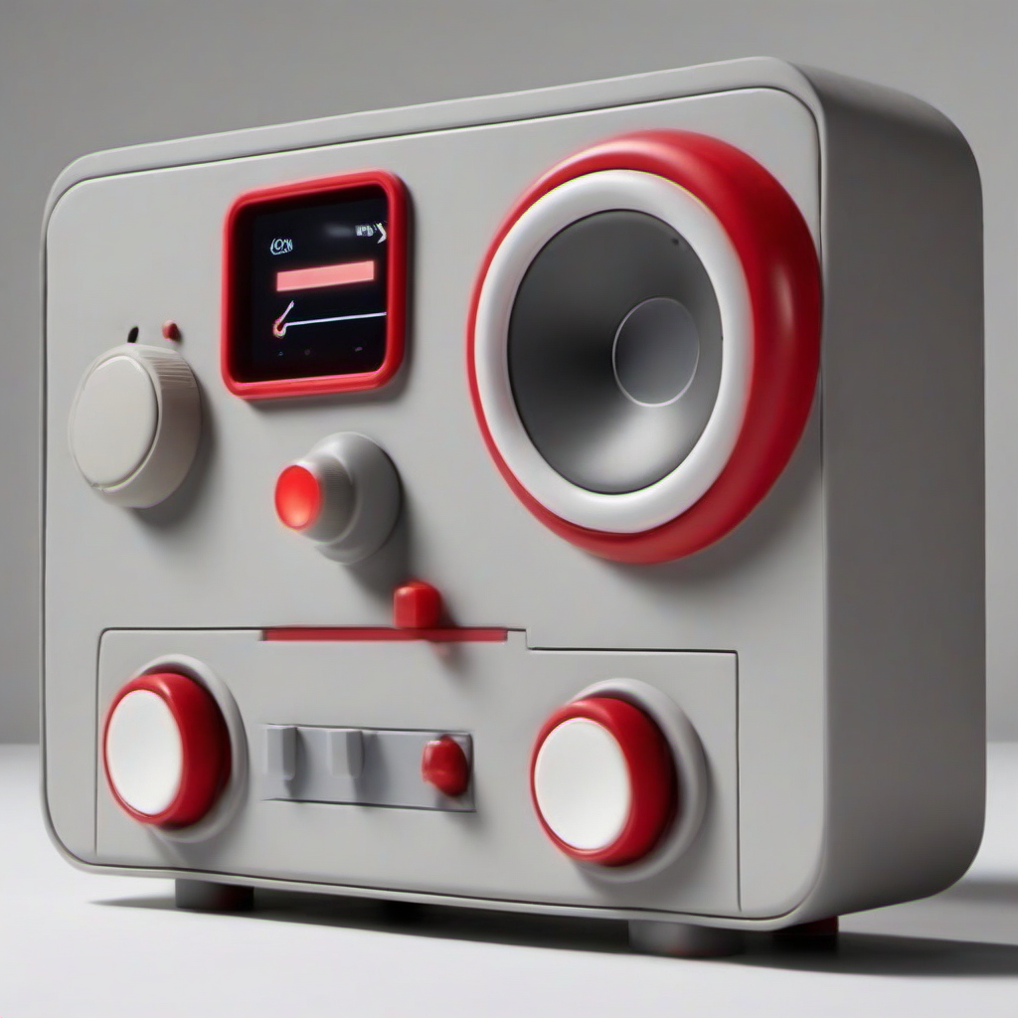
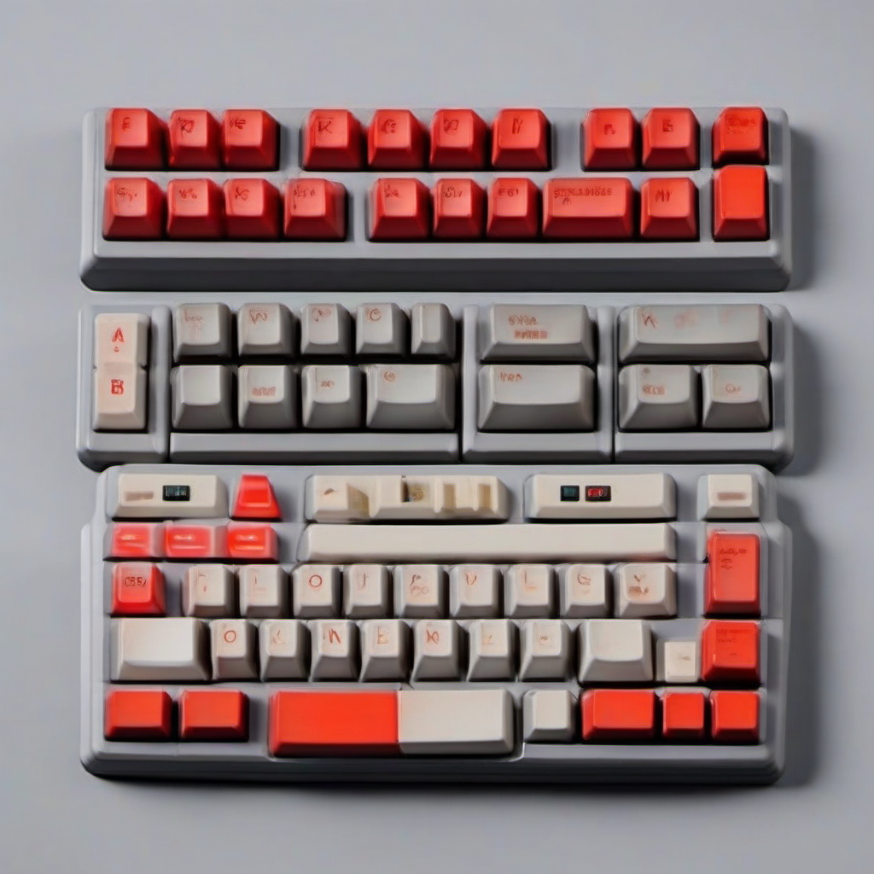
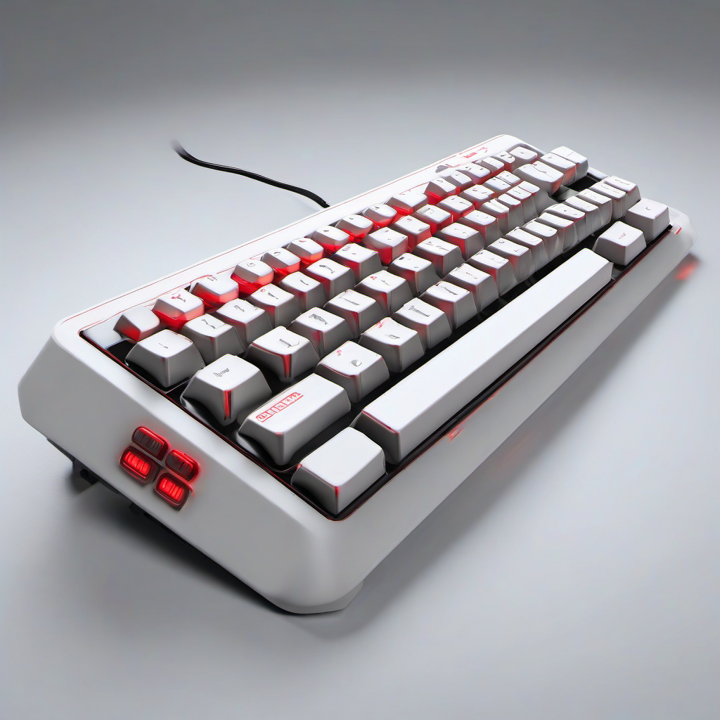
Product 2 (Keyboard)
OpenAI
Key Findings:
OpenAI captures the color scheme (cream gray + red) but often misinterprets the product as a retro console or button box rather than a full keyboard.
Layout accuracy is low: OpenAI struggles with accurate key arrangement, legends, and overall keyboard proportions.
SDXL outputs show stronger realism but frequently hallucinate incorrect forms (e.g., audio equipment, multi-piece boards, random knob placement).
Both models capture the retro aesthetic, but neither achieves true product-level accuracy in geometry or layout.
SDXL

Slide 15
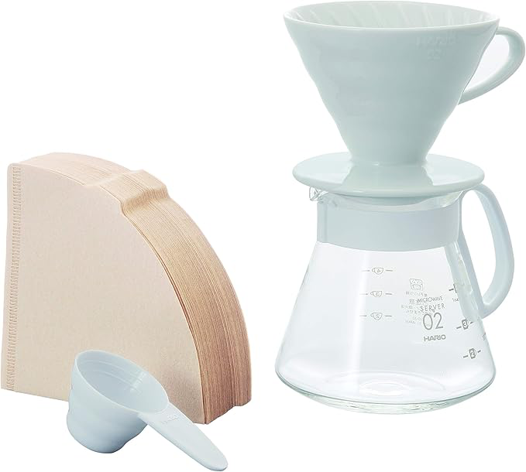
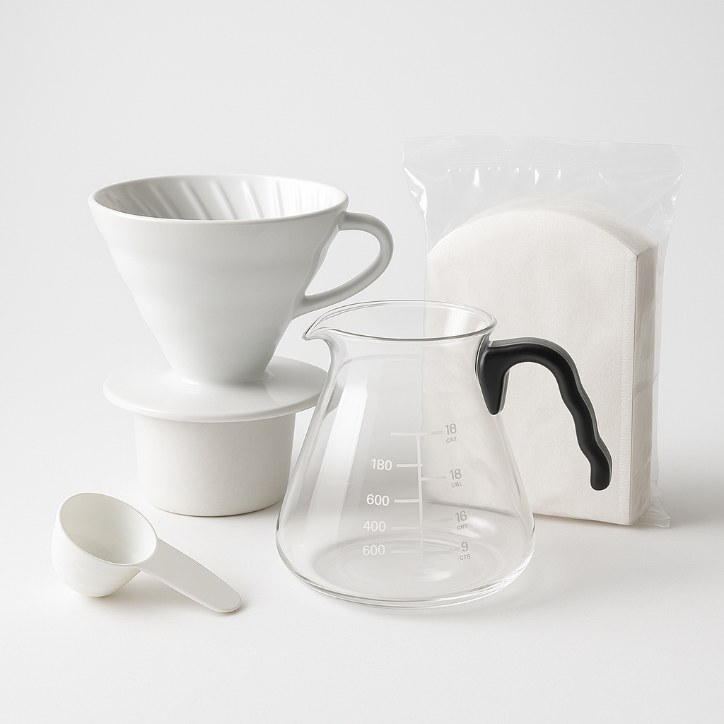
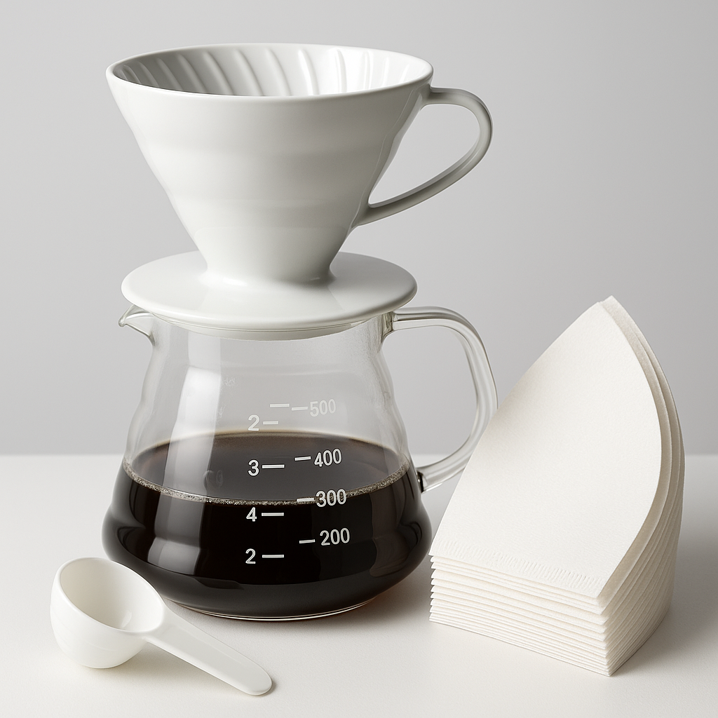
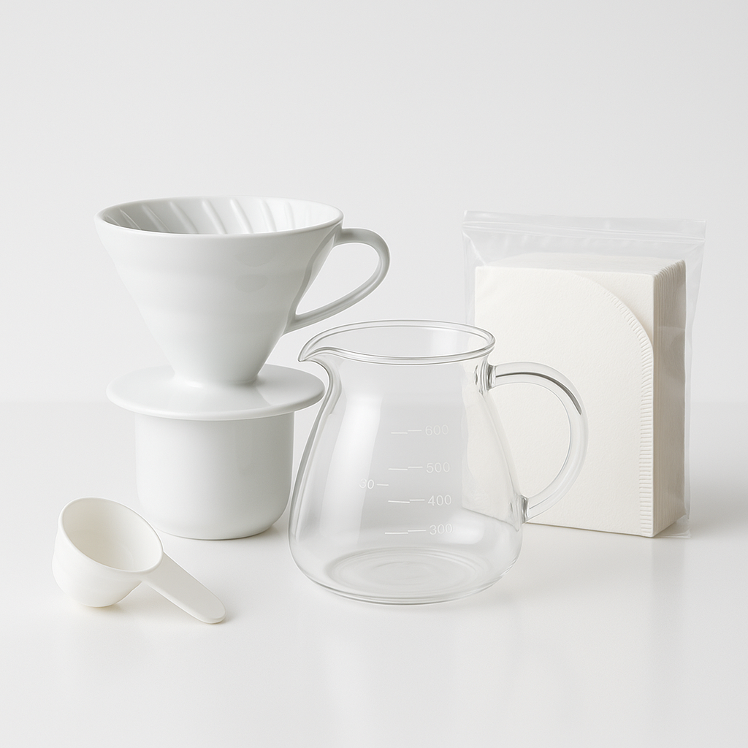
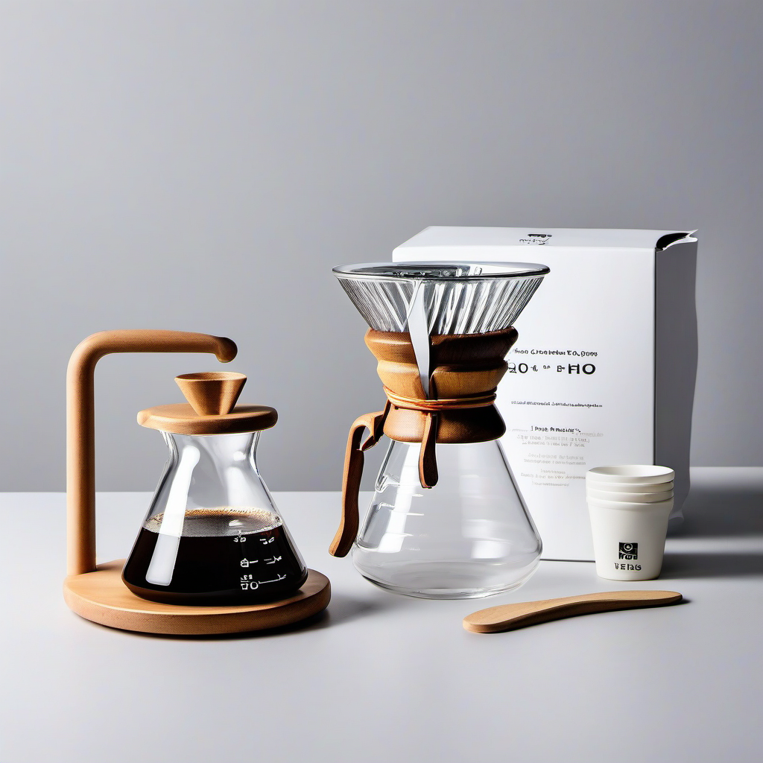

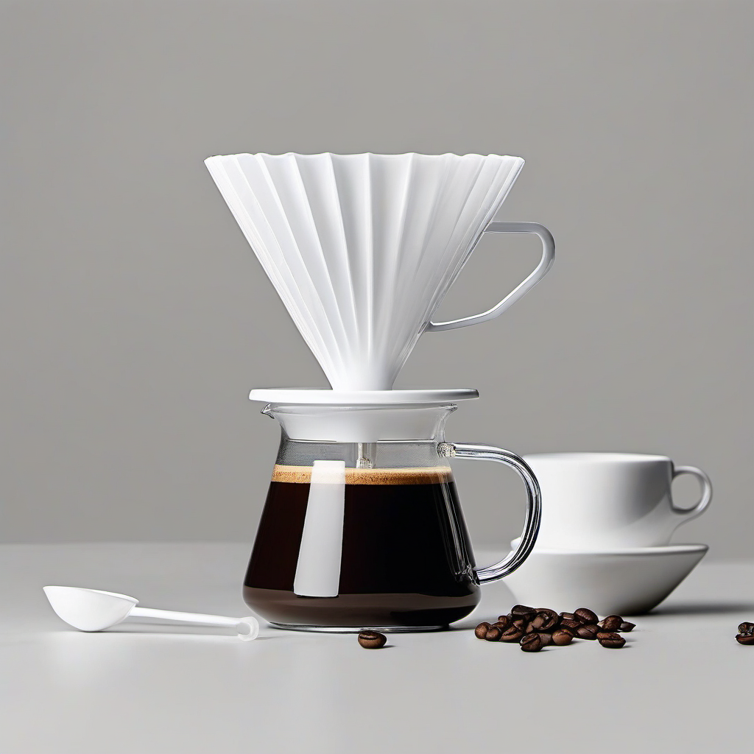
Product 3 (Hario Pour Over Coffee Set)
OpenAI
Key Findings:
OpenAI accurately generated all core components (ceramic dripper, glass server, paper filters, scoop) with correct overall arrangement.
The dripper shape (V60 cone + spiral ribs) is captured reasonably well
The glass carafe shape matches the real product, but measurement markings are inconsistent, and may missing.
Paper filters are recognized correctly as stacked fan shapes, but thickness and orientation vary.
SDXL outputs show high realism but significant semantic drift, like introducing wood bases, metal stands, or unrelated brewing accessories.
SDXL

Slide 16
Image Generation Summary
OpenAI → higher accuracy, better at capturing correct shape, layout, and components.
SDXL → more photorealistic, but often hallucinates unrelated product forms.
Structured prompts produce the most consistent and faithful results.
Both models struggle with fine details, UI icons, and precise component geometry.
Customer reviews provide enough signal for approximate product reconstruction, but not exact replication.

Slide 17
AI Agentic Workflow
Researcher Agent
Function: Data ingestion
Live Mode: Selenium-based scraping of Amazon product pages (descriptions, reviews)
Analyst Agent
Function: Use LLMs (GPT-4o) to parse unstructured text
Output: Extracts objective visual features and computes sentiment analysis
Creative Agent
Function: Convert analyst output into a high-fidelity image-generation prompt optimized for diffusion models
Visualizer Agent
Function: Use DALL·E 3 to generate a visual prototype from the creative prompt

Slide 18
AI Agentic Workflow
Demo

Slide 19
Challenges and Limitations
NOISY REVIEWS
DATASET GENERALIZABILITY
METRIC FOR GENERATED IMAGE
User reviews often contain inconsistent language and irrelevant information, making it difficult to extract reliable insights for image generation.
Relying on a small subset of customer reviews (5-50), the extracted visual features may not fully represent the product, limiting the generalizability and accuracy of the generated images.
There is no fixed or standardized metric to evaluate the quality of the generated images or to objectively compare them with real product images, making assessment largely subjective.
Notes:
Although our system performs well across different product categories, we identified several important challenges and limitations.
The first challenge is noisy reviews. Customer reviews often contain inconsistent descriptions, emotional language, or irrelevant stories. This makes it difficult for the model to reliably extract accurate visual attributes.
Second, dataset generalizability. Our current experiment uses a relatively small subset of reviews—typically between 5 and 50 per product. This limited sample may not fully capture the product’s full appearance or variations, which restricts the generalizability of the generated images.
Third, the evaluation metric. At the moment, there is no standardized metric to quantitatively measure how close the generated image is to the real product. Most assessments are subjective, which introduces bias and makes it harder to compare models or prompts in a rigorous way.
These limitations highlight the gap between text-derived product understanding and faithful visual reconstruction, and they guide the improvements we propose in the next slide.

Slide 20
Future Enhancements
CHUNKING
GENERATION IMPROVEMENT
PIPELINE ENHANCEMENT
Implementing more effective chunking strategies will preserve full contextual meaning across reviews, allowing the LLM to extract richer and more accurate visual features. This enhancement would reduce information loss and ultimately lead to more faithful, higher-quality product image generation.
Different structure of extracted information could be tested to achieve higher quality.
Fine-tuning the generation model using a selected similarity metric would help the model produce images that more closely match the real product’s appearance.
Iteratively feeding both the generated images and the original image back into the agent can progressively improve image quality.
Try a multiple agent workflow with each agent assigned specific task with high performance.
Notes:
Based on the challenges we observed, we propose several directions for future enhancement.
First, improving chunking. By applying a more robust chunking strategy, we can better segment long or noisy reviews into cleaner semantic units. This reduces noise, improves feature extraction accuracy, and ultimately leads to more consistent image generation.
Second, fine-tuning the image generation model. Instead of using generic diffusion models, we can fine-tune on selected product-focused datasets or even on our extracted visual attributes. This should increase the structural accuracy and reduce hallucinations.
Third, iteratively refining images. We can adopt a loop where the agent compares the generated image with the original product photo, extracts the differences, and feeds correction prompts back into the model. This iterative improvement can significantly enhance fidelity.
Lastly, building a multi-agent workflow. Each agent can specialize in a subtask—such as attribute extraction, prompt optimization, quality evaluation, or image refinement—allowing the pipeline to become more modular, scalable, and accurate.
With these enhancements, we expect the system to move closer to reliable, high-precision text-to-image generation for real-world product applications.

Slide 21


Thank You for Your Attention

